Slide 1
Real-Time Machine Learning Algorithms For Predicting Traffic Flow
Vehicular networks Cnt 6528-002

Slide 2
Team
Jaswanth Reddy Vulchi – Z23754058
Deepak Punugupati – Z23752259
Karthya Reddy Vitalam – Z23752177
Meghana Valeti – Z23751882
Menthula Paul Chakravarthi – Z23762484

Slide 3
Introduction
Enhance traffic management strategies, reducing congestion and improving efficiency.
Accurate predictions aid in enhancing road safety measures.
Real-time traffic information empowers commuters to make informed travel decisions, optimizing their experience.
Efficient traffic flow contributes to environmental sustainability by reducing fuel consumption and emissions.
Infrastructure planning, facilitating resource allocation for future development.
Real-time traffic insights support emergency response efforts, ensuring timely assistance during crises.
Public transportation systems benefit from optimized schedules and routes based on demand predictions.
Urban development decisions

Slide 4
Problem
Traffic congestion is a pervasive issue in urban areas worldwide, leading to significant economic losses, environmental pollution, and reduced quality of life for residents.
Effectively managing and predicting traffic flow is crucial for mitigating these challenges and ensuring efficient transportation systems.
Machine learning algorithms offer a wide range of approaches to address this problem by leveraging historical traffic data to forecast future traffic conditions.

Slide 5
Algorithms
Linear Regression- Actual vs Predicted Monthly Traffic Volume
Random Forest- It is a popular machine-learning algorithm that belongs to the ensemble learning family. It operates by constructing multiple decision trees during training and outputs the mode of the classes (classification) or mean prediction (regression) of individual trees. (predicts high or low traffic)
Logistic Regression- Accuracy 79.16% (Y dependent variable Vehicles and X trained data)
Support Vector Machine- Accuracy 82.55% (Closer to Random Forest)

Slide 6
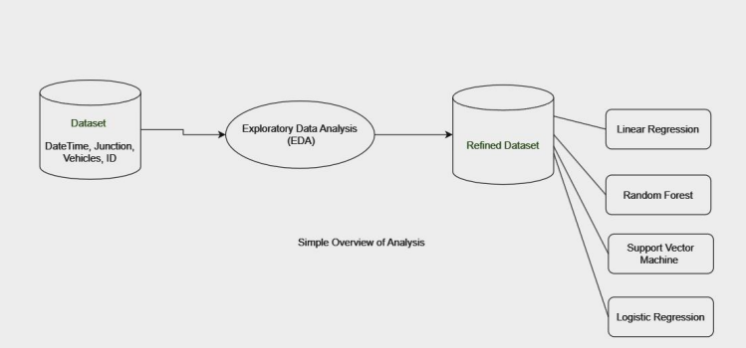
Overview

Slide 7
Implementation
Dataset collection from Kaggle
Histplot for traffic distribution
Traffic volume distribution along each junction- Violin plot
Average Traffic Volume- Hourly & Weekly
Linear Regression Monthly Traffic Volume (Actual & Predicted)
Random Forest Classifier
Logistic Regression
Support Vector Machine

Slide 8
Conclusion
The utilization of the Random Forest algorithm for predicting traffic flow demonstrates good and expected results, with notably higher accuracy compared to alternative algorithms (Support Vector Machine, Linear Regression, and Logistic Regression ).
Through rigorous training and testing, our model exhibits robust performance in forecasting traffic levels at various junctions, enabling proactive measures for congestion mitigation and transportation planning.
By leveraging this algorithm, urban authorities can optimize traffic flow, road safety, and improve overall transportation efficiency. This model predictions may wrong if there is an intervention of external features like whether conditions, accidents on junctions etc.
Moving forward, further research and refinement of the model to account for additional external factors will continue to advance the development of intelligent transportation systems and contribute to the creation of more sustainable and livable urban environments.

Slide 9
Thank You

